Slide 1
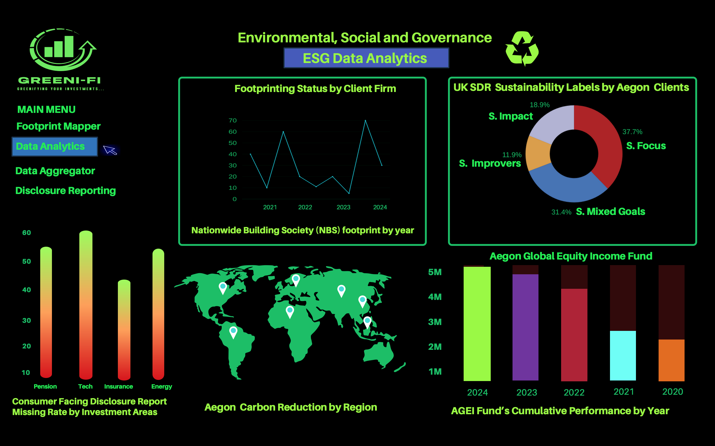
AI-enabled Cloud Analytics Platform: GREENI-FI
-

Slide 2




Our EcoFund Team
MSc International Business Data Analytics Students
London Campus
Chiranjibee Sangroula
Business Analyst
Ayodeji Saraki
IT Project Manager
Muhammad Salman
Data Analyst
Ongoing MSc Thesis related to ‘Sustainable Packaging and E-commerce’
Ongoing MSc Thesis related to ‘Generative AI and Academic Assessments ’
Ongoing MSc Thesis related to ‘Data Analytics and Business Performance’
Founders of Infinity Club London in Ulster University conducting collaborative events, experts panel discussions and hackathons brings together tech, AI and business one event at a time.

Slide 3

Aegon UK: Portfolio Decarbonization
Why this Challenge ?
Funding is Lifeblood to all low-carbon and carbon-intensive businesses.
81% Adult want their money invested to do good and get ROI whereas 76% want their money invested in a way that protects environment (FCA Financial Survey, 2023).
Aegon UK is a largest investment platform advocating towards greenifying Finance. The more Aegon decarbonizes, the wider will be the spiral effect to decarbonize its client companies and Funds (Aegon UK, 2024).
Nearly 24 millions Customers, Engagement with Top 19 UK Corporate Emitters & €826 Billions Investments (Aegon Annual Report, 2023).
Weighted average carbon intensity: 338 tCO2e/EURm revenue (Companies House, 2024).
Earns revenue selling financial services such as retirement, insurance and investment solutions directly to Individuals, Advisers and Employers in UK.
Notes:
Investment Platform: Allocation and Investment of Funds in profitable Equities. Invests through own businesses, partner and parent firms globally.
Via Key Products & Services: IPS with investment options of over 40 Funds (via GIA), ISA , Stocks and Share ISA and Personal Pension

Slide 4

Research and
Problem Statement: Aegon UK Portfolio Decarbonization
Problem has been framed as “Challenge of accurately measuring carbon footprint of companies and funds Aegon UK is in business, with reliable climate risks related data and seamless data access from industry-wide stakeholders, to ensure alignment with compliance reporting standard such as UK SDR ”.
Why this demands attention and solution ?
To avoid misaligned and incomplete SDR reporting.
To reduce costs and promote smooth operational dataflow in climate risks and ESG data.
To avoid existing and upcoming regulatory hurdles.
To track and reduce the financed emissions footprint.

Slide 5
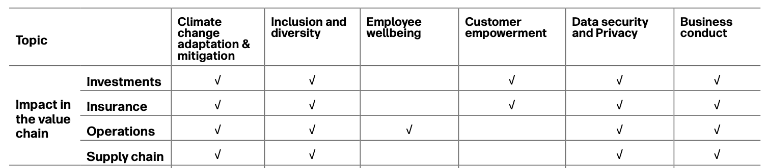
Data and Research
On the one hand, accurate measuring of carbon footprint of financed emissions and climate-related data gaps has been a major challenge for many giants including Aegon UK, on the other hand, Euromonitor global consumer trend 2024 survey indicates Consumers are flagging corporate greenwashing specially misleading claims and demand genuine evidence of sustainability impacts or evidences (Noel et. al, 2023; Euromonitor International, 2024).
From professional level, NGFS Expert Network on Data (EN Data) was launched at the beginning of 2023 in attempt to bridge Climate-related Data Gaps. While from Corporate levels, companies including Aegon UK have been using different frameworks and technologies (NGFS, 2024)
Aegon UK, a signatory of NZAOA (Net Zero Asset Owner Reliance) , UN PRI (Principles of Responsible Investment) highlights actions taken to identified material topics during its second Double Materiality Assessment in 2023 complying EU’s CSRD. Most targets achieved or on track.
(Aegon Annual Report, 2023)
Notes:
Platform designed from findings showing 60% of companies face difficulties in accurate emissions tracking (Shabir et al., 2023).
As per Aegon’s responsible investment framework, Aegon UK is committed to transition general account investment portfolio* to net-zero greenhouse gas (GHG) emissions by 2050 setting clear medium-term targets for 2025, against a 2019 baseline:
Reducing the weighted average carbon intensity of our corporate fixed income and listed equity general account assets by 25%;
Reducing the scope 1 and 2 carbon intensity of our directly-held real estate investments by 25% (kgCO2e/m2);
Investing USD 2.5 billion in activities to help mitigate climate change or adapt to the associated impacts; and
Engaging with at least the top 20 corporate carbon emitters in the portfolio.
We have embarked on a journey to transition Aegon's investment portfolio to net-zero emissions by 2050.
Lard Friese, CEO Aegon

Slide 6
Data and Research
Competitor Benchmarking
Firms | Process/Technology | Main Features | Limitations | Source
Aegon UK | Double Materiality Assessment (DMA) MSCI Climate Data, Clarity AI | Integrates ESG factors, climate risk analytics, reporting tools | Limited scope for individual investment assessments, Limitations on cross-industry data sharing, data aggregation and reporting | (Annual Report 2023; Aegon UK, 2024)
Zurich Insurance | Ortec Finance Climate Navigator, DMA | Climate risk integration, forward-looking risk metrics | High model dependency, regulatory compliance pressures | (Zurich UK, 2024)
M & G Investments | Carbon Intelligence Platform Sustainalytics | Focuses on reducing Scope 1, 2, and 3 emissions, asset-level reporting predictive analytics | data integration challenges, resource-intensive data processing, limitations on depth | (M & G Investments, 2024)
Legal & General | Carbon Trust & SBTi | Carbon reduction strategy and science-based targets | May require third-party verification and updates | (Legal & General, 2024)
Gap Analysis
Gap Analysis
.
Process Gap: Aegon UK has sound ESG policies and formal DMA process in place to monitor, track and reduce financed emissions, ultimately contributing in decarbonizing its portfolio.
Technology Gap: Despite progress, Aegon acknowledges difficulties in measuring climate-related risks, especially due to limited data availability and the evolving nature of climate modeling. Ensuring accurate and comprehensive climate risk assessments for its portfolio remains a significant hurdle. A solution which can holistically address the end-to-end ESG & climate-related data has been observed as a technology gap during research specially now as easier emissions reductions (Scope 1 & 2 emissions) are already achieved.
Notes:
Operational Emissions: Although Aegon has achieved significant reductions in scope 1 and 2 emissions, further progress could become more difficult as easier emissions reductions are achieved. Continued innovation in energy efficiency and sustainability practices will be needed to meet future targets.

Slide 7

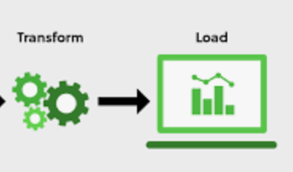


An AI-enabled cloud platform with features to measure carbon footprint, seamlessly access industry-wise sustainability data, reconcile and standardize it to align with industry-standard compliance reporting.
Proposed Idea
SDR Reporting
Standardized reporting based on applicable Sustainability Labels of SDR Framework and other frameworks
Data Reconciling
Data Aggregation Functions, ETL, Cleansing Algorithms and Schema Mapping
Data Collection
Through Data ingestion pipelines and AI-enabled real-time monitoring
Measure Footprint
Through analysis of Value Chain Activities [DMA]
& KPIs

Slide 8
Technology: AI-enabled Cloud Analytics Solution

Slide 9
Technology: Viability, Accessibility & ROI
Estimated Cost: £156,000 - £251,000 [ Estimates are based on aggregation of front-end and back-end design cost by developers, UX Designing, Cloud hosting, machine Learning library access, data storage, privacy and security]
Accessibility: Platform will be accessible to all trial version subscribers through Cloud Service Provider platform. Full Proprietary copyright of Aegon UK. Even though originally planned for Aegon UK’s use, this end-to-end ESG data analytics solutions will be sold through Aegon UK marketing channel and social medias.
Anticipated Users: Aegon UK employees, Fund Managers (UK & Overseas) , Aegon UK’s Client Firms, Business Analysts, Analysts in Compliance or Regulatory department of any interested Financial Institutions and Service Providers within UK and Overseas, NGOs and INGOs Agents
Return On Investment (ROI) : The SaaS platform will be under pilot project for testing. Once successful and goes live, the extensive marketing kicking off with free version followed by free trail and upgrade to subscription-based individual and institutional sales is expected to cover the cost within first three year of its launch even if moderate Sales.

Slide 10
Impacts and Values
Energy Efficiency and Emissions Reduction
Anticipated 15% aggregated decrease in Aegon’s financed emissions and energy use [including scope 3 emissions, real estate assets and other asset classes], equating to an annual reduction of ~1.5 million tons of CO₂, similar with emissions from 300,000+ vehicles (Accenture, 2023; Equans, 2023).
Uniqueness & Future-oriented
Integrates advanced AI with real-time analytics for emissions tracking and operational optimization as 70% leaders have acknowledged AI's role in decarbonization, and more firms are in process of adoption (PwC, 2023).
Workplace Pension and Insurance Integration
Smooth ESG data accessibility and analytics feature poise significant benefits in further integrating Aegon UK’s workplace pension funds with Net Zero goals and leverage even better in UK’s Defined Contribution (DC) pension space. Similarly, Aegon’s Insurance Schemes integration and engagements with UK Top 20 corporate emitters can be fortified too (Aegon Annual Report, 2023).
Minimizes Costs & Transition Risks
Compliance Aid
Key tool to meet UK and EU Sustainability Disclosure Requirements transforming, aggregating and reconciling ESG data from all stakeholders Aegon UK is involved with while facilitating industry-wise collaboration towards decarbonization of own as well as client’s portfolio (Financial Conduct Authority, 2023)
This latest robust technology will enable Aegon UK to track and reduce the leakages by 10% (anticipated) across its value creating operations activities while being adaptive to regulatory shifts and recent climate modelling and resilient to potential disruptions caused by swift implementation of Net Zero and other SDG goals (United Nations, 2024).

Slide 11
References
Aegon UK (2019). Investing responsibly matters | Aegon. [online] Aegon.co.uk. Available at: https://www.aegon.co.uk/corporate-sustainability/investing-responsibly-matters [Accessed 6 Nov. 2024].
Aegon UK (2024a). Corporate sustainability | Aegon UK. [online] Aegon.co.uk. Available at: https://www.aegon.co.uk/corporate-sustainability [Accessed 6 Nov. 2024].
Aegon UK (2024b). LinkedIn. [online] Linkedin.com. Available at: https://www.linkedin.com/company/aegonuk/posts/?feedView=all [Accessed 6 Nov. 2024].
Aegon UK (2023). Helping people live their best lives Integrated Annual Report 2023. [online] Available at: https://www.aegon.com/system/files/file/2024-04/aegon-integrated-annual-report-2023.pdf [Accessed 21 Oct. 2024].
BCS (2021). What is UX and how should it be taught? [online] Bcs.org. Available at: https://www.bcs.org/articles-opinion-and-research/what-is-ux-and-how-should-it-be-taught/ [Accessed 7 Nov. 2024].
Companies House (2024). AEGON UK PLC filing history - Find and update company information - GOV.UK. [online] Service.gov.uk. Available at: https://find-and-update.company-information.service.gov.uk/company/03679296/filing-history [Accessed 7 Nov. 2024].
Confluence (2024). Sustainathon: Design Thinking-Empathize . [online] Atlassian.net. Available at: https://tcssustainathonproject.atlassian.net/wiki/spaces/SCRUM/pages/2916353/Empathizing+and+Defining+the+Aegon+UK+Decarbonisation+Problem [Accessed 10 Nov. 2024].
Equans (2023). How Artificial Intelligence (AI) is driving decarbonisation. [online] www.equans.com. Available at: https://www.equans.com/news/how-artificial-intelligence-is-driving-decarbonisation [Accessed 10 Nov. 2024].
Equinor (2023). The British energy revolution. [online] www.equinor.com. Available at: https://www.equinor.com/magazine/uk-journey-from-coal-to-net-zero [Accessed 10 Nov. 2024].
Euromonitor International (2024).Top Global Consumer Trends 2024 [online] Euromonitor.com. Available at: https://www.portal.euromonitor.com/analysis/permalink?permalinkId=60dd8bad-9e2a-4147-9b84-635983a210cc [Accessed 5 Nov. 2024].
Financial Conduct Authority (2023). Sustainability Disclosure Requirements (SDR) and investment labels This relates to. [online] Available at: https://www.fca.org.uk/publication/policy/ps23-16.pdf [Accessed 8 Nov. 2024].
Jira (2024). Agile Board - Jira. [online] Atlassian.net. Available at: https://tcssustainathonproject.atlassian.net/jira/software/projects/SCRUM/boards/1 [Accessed 10 Nov. 2024].
Legal & General (2024). Environment | Environment Social Governance (ESG) | Legal & General. [online] www.legalandgeneral.com. Available at: https://www.legalandgeneral.com/esg-workplace/environment/ [Accessed 10 Nov. 2024].
M & G Investments (2024). Sustainability-Disclosures. [online] Mandg.com. Available at: https://www.mandg.com/footer/sustainability-disclosures [Accessed 10 Nov. 2024].

Slide 12
References
NGFS (2024). Network for Greening the Financial System Information Note Improving Greenhouse Gas Emissions Data Foreword 4. [online] Available at: https://www.ngfs.net/sites/default/files/medias/documents/ngfs_information_note_on_improving_ghg_emission_data.pdf [Accessed 10 Nov. 2024].
Noels, J., et al. (2023), “Climate change mitigation scenarios for financial sector target setting and alignment assessment: A stocktake and analysis of their Paris-consistency, practicality and assumptions”, OECD Environment Working Papers, No 223, OECD Publishing, Paris, https://doi.org/10.1787/bcd25b82-en.
Paul, D. and Cadle, J. (2020). Business analysis. 4th ed. Swindon, United Kingdom: BCS Learning & Development Limited.
PwC (2023). UK Sustainability Disclosure Requirements: How Can You Prepare?. Retrieved from https://www.equans.com/news/how-artificial-intelligence-is-driving-decarbonisation [Accessed 6 Nov. 2024]
Shabir, I., Dash, K. K., Dar, A. H., Pandey, V. K., Fayaz, U., Srivastava, S., & Nisha, R. (2023). Carbon footprints evaluation for sustainable food processing system development: A comprehensive review. Future Foods, 7, 100215. https://doi.org/10.1016/j.fufo.2023.100215
Stanford University (2010). An Introduction to Design Thinking PROCESS GUIDE by Hasso Plattner. [online] Stanford University. Available at: https://web.stanford.edu/~mshanks/MichaelShanks/files/509554.pdf [Accessed 7 Nov. 2024].
TCS (2024a). Measuring Sustainability and Net Zero Emissions with the ReScore App. [online] Tcs.com. Available at: https://www.tcs.com/who-we-are/sports-sponsorships/tcs-london-marathon-making-difference/article/london-marathon-rescore-app-measure-sustainability [Accessed 4 Nov. 2024].
TCS (2024b). TCS Sustainathon. [online] Tcsapps.com. Available at: https://sustainathon.tcsapps.com/events/ongoing/UKI2024 [Accessed 6 Nov. 2024].
TCS Annual Report (2024). Innovate, Adapt, Thrive Integrated Annual Report 2022-23. [online] Available at: https://www.tcs.com/content/dam/tcs/investor-relations/financial-statements/2022-23/ar/annual-report-2022-2023.pdf [Accessed 5 Nov. 2024].
United Nations (2024). Goal 12 | Ensure Sustainable Consumption and Production Patterns. [online] United Nations. Available at: https://sdgs.un.org/goals/goal12 [Accessed 6 Nov. 2024].
Voil, N.D. (2020). User experience foundations. Swindon: BCS.
Zurich UK (2024). Zurich Insurance. [online] Zurich.co.uk. Available at: https://www.zurich.co.uk/sustainability [Accessed 10 Nov. 2024].

